Slide 1
Module 3 Topic 4 Fuel cell Technology

Slide 2
STATIONARY POWER GENERATION BY FUEL CELL
fuel cell micro-CHP units have been deployed in Japan
Germany is another country that is promoting micro-CHP units
Mitsubishi Heavy Industries is developing large Scale fuel cell combine cycle industrial power plants comprising of SOFC / gas turbine / steam turbine of 0.25 MW to 80 MW with natural gas as fuel
Nedstack installed a 1 MW PEMFC power plant at Solvay's Antwerp chlor-alkali plant in Sept., 2011 and provides efficiency of about 80% in CHP mode
Ballard commissioned a I MW system at headquarter of Toyota USA in 2012
FuelCeII Energy (MCFC, 300 kW), Bloom Energy (SOFC, 200kW) and ClearEdge (PAFC, 400kW) are the dominant players in stationary power sector

Slide 3
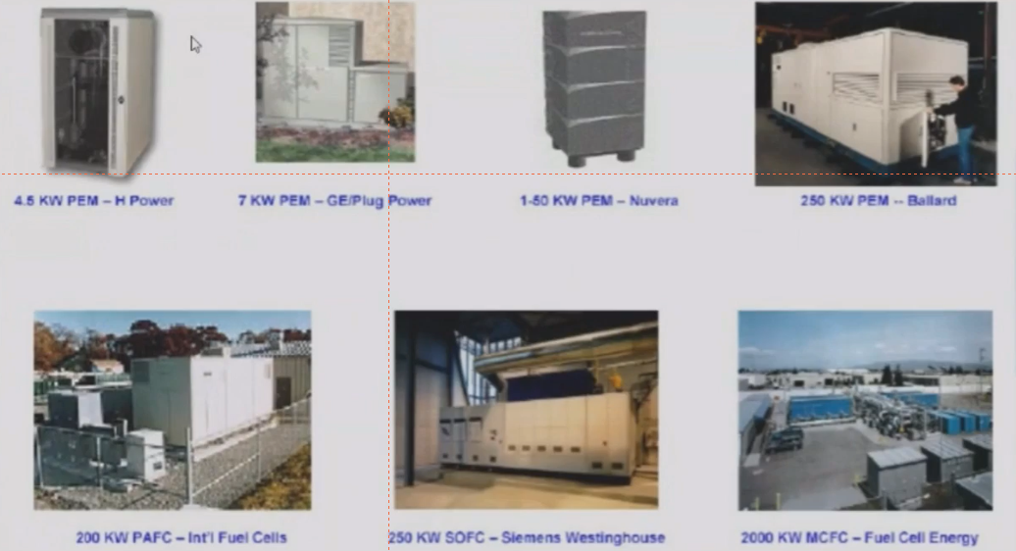

Slide 4
APPLICATIONS OF FUEL CELLS
Application Type | Portable | Stationary | Transport
Definition | Units that are built into, or charge up, products that are designed to be moved, including auxiliary power units (APU) | Units that provide electricity (and sometimes heat) but are not designed to be moved | Units that provide propulsive power or range extension to a vehicle
Typical range power | 5 W to 20 MW | 0.5 kW to MW | 1KW to 100 kW
Typical technology | PEMFC DMFC |  | PEMFC DMFC
Examples | - Non-motive APU - Military application - Portable products - Large personal devices - Education kits and toys | - Large stationary CHP - Small stationary micro-CHP - UPS | - Forklifts - Cars & scooters - Trucks and buses

Slide 5
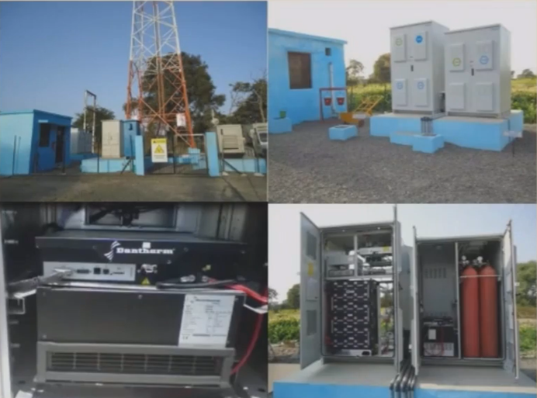
FUEL CELL IN TELECOM TOWER
— 4.50 lakh telecom towers in India
75% of rural & 33% of urban
towers running on alternative
energy
— 30 towers in MP (near Nagda)
were set up for providing back up
power from fuel cells
H2 supply from Nagda Chlor-alkali
plant
PEM Fuel cell systems have also
been installed in about 100 towers
by Reliance Jio

Slide 6

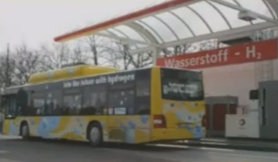
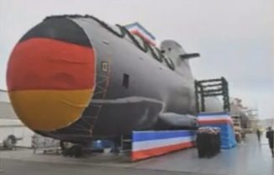


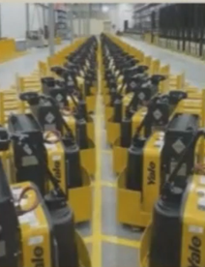
VEHICLES RUNNING ON FUEL CELLS

Slide 7
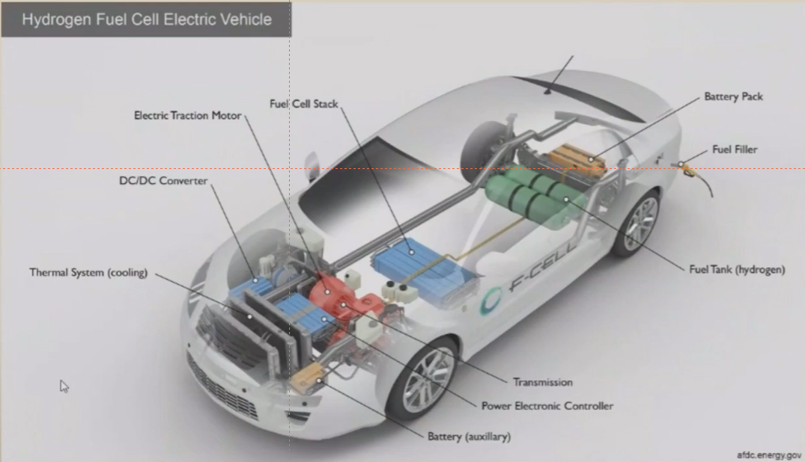

Slide 8
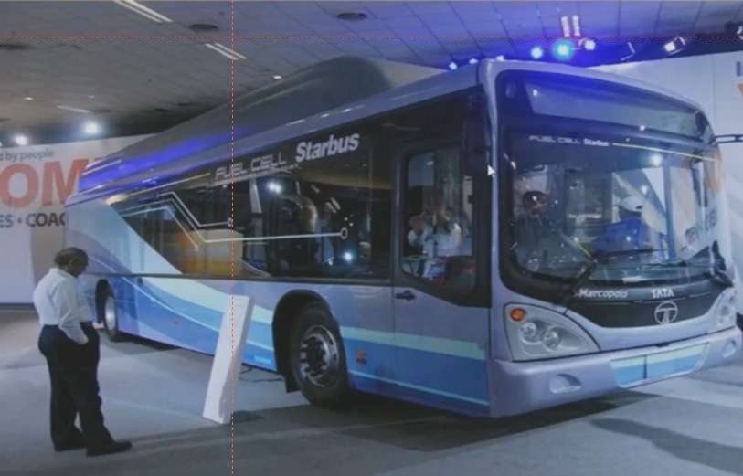
STARBUS BY TATA MOTORS

Slide 9
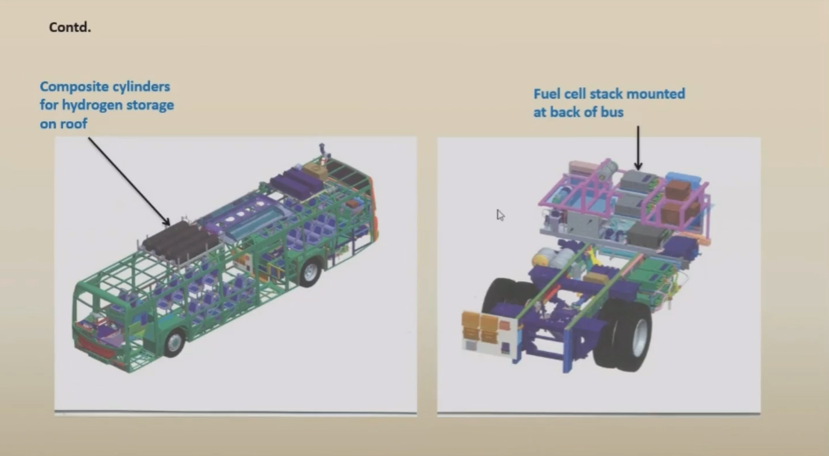

Slide 10
Technical Specifications
Type of Fuel Cell | PEMFC
FC Gross Peak power | 85 kW
Air compressor for FC | Single stage Twin Screw
Total useful amount of Fuel | 14.5 kg
Fuel System | Roof- mounted hydrogen cylinder (4 in nos.)
Peak power output of motor | 186 kW

Slide 11
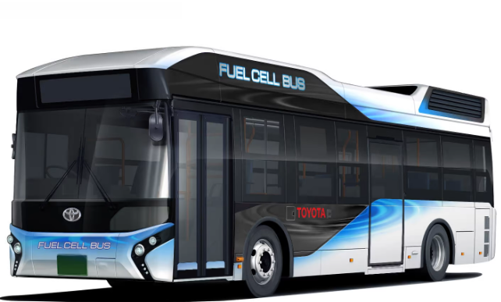
SORA FUEL CELL BUS BY TOYOTA
S- Sky; O- Ocean; R- River; A- Air (These represent the earth's water cycle)

Slide 12
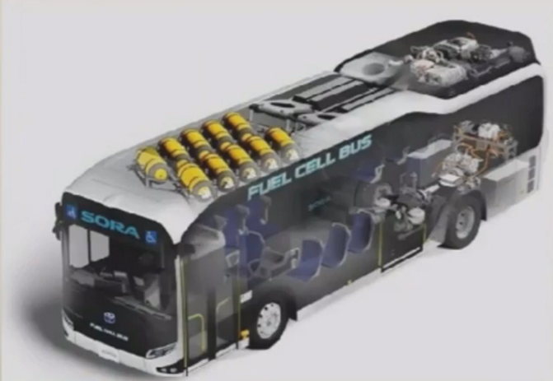
Vehicle Name Length /width / height capacity (seated, standing and driver) Pc stock Name(type) Maximum output | Sora 10,525 / 2,490/ 3,350 mm 79 (22+56+1) Toyota FC stack (solid polymer electrolyte) 114 KW x 2(155PS x 2 )
Motor type Maximum output Maximum torque High – pressure Number of tanks Hydrogen tank (nominal working pressure) Tank internal volume Drive battery Type External power maximum output / Supply system power supply amount | AC synchronous 113 KW x 2 (154PS x 2) 335 N – m x 2 (34.2 kgf – m x 2) 10 (70 Mps) 600 Liters Nickel – metal hydride 9 KW / 235 Kwh

Slide 13
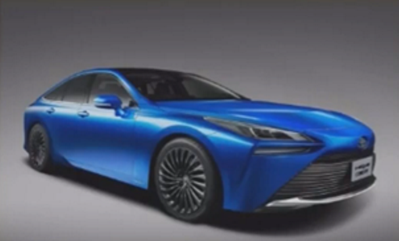
TOYOTA MIRAI
Vehicle | Cruising range Maximum speed | Approx. 550 km Estimated, according to NEDC Cycle 178 km/h
Fuel cell stack | Volume power Density Maximum output | 3.1 kw/L (world top level *2) 114 kw (155 DIN hp)
High-pressure Hydrogen tank | Number of tanks Nominal working Pressure Tank storage Density *3 | 2 70 Mpa (700 bar) 5.7 wt% (world top level *2)
Motor | Maximum output Maximum torque | 113 kw (154 DIN hp) 335 Nm

Slide 14
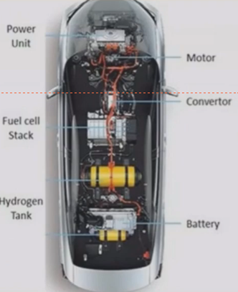

Slide 15
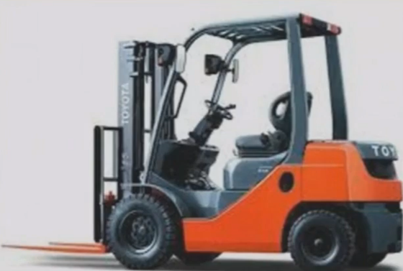
TOYOTA FORKLIFS
90% of total fleet of forklift in Toyota are electric
These are power through Li-ion batteries
and Fuel cell
Toyota boasts of having about 15 years of
experience of using hydrogen forklifts

Slide 16
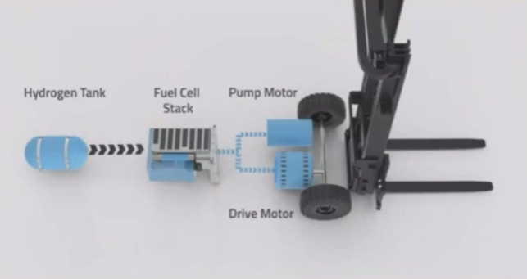
• Forklift consists of :
the fuel cell stack,
the 350-bar hydrogen tank,
a small lithium-ion
battery, and
a fan.
Contained in a small cast
frame which is of a size of lead
acid battery
Can be easily installed

Slide 17
Thank You

